Slide 1

NODE JS
Aruna S
Department of
Computer Science and Engineering

Slide 2

NODE JS
NodeJS Introduction
S. Aruna
Department of Computer Science and Engineering

Slide 3
NODE JS
NodeJS Introduction
Node.js is an open source, cross-platform runtime environment built on Google Chrome's JavaScript Engine (V8 Engine).
Node.js was developed by Ryan Dahl in 2009 and its latest version is v12.18.3
Node.js is a platform built on chrome’s JavaScript runtime for easily building fast and scalable network applications.
Node.js uses an event-driven, non-blocking I/O model that makes it lightweight and efficient, perfect for data-intensive real-time applications that run across distributed devices.
Node.js is open source, completely free, and used by thousands of developers around the world.

Slide 4
NODE JS
NodeJS Introduction
Node.js applications are written in JavaScript, and can be run within the Node.js runtime on OS X, Microsoft Windows, and Linux.
Node.js also provides a rich library of various JavaScript modules which simplifies the development of web applications using Node.js to a great extent.
Node.js = Runtime Environment + JavaScript Library

Slide 5
NODE JS
Why Node?
When you create websites with PHP for example, you associate the language with an HTTP web server such as Apache or Nginx. Each of them has its own role in the process:
Apache manages HTTP requests to connect to the server. Its role is more or less to manage the in/out traffic.
PHP runs the .php file code and sends the result to Apache, which then sends it to the visitor.
As several visitors can request a page from the server at the same time, Apache is responsible for spreading them out and running different threads at the same time.
Each thread uses a different processor on the server (or a processor core)

Slide 6
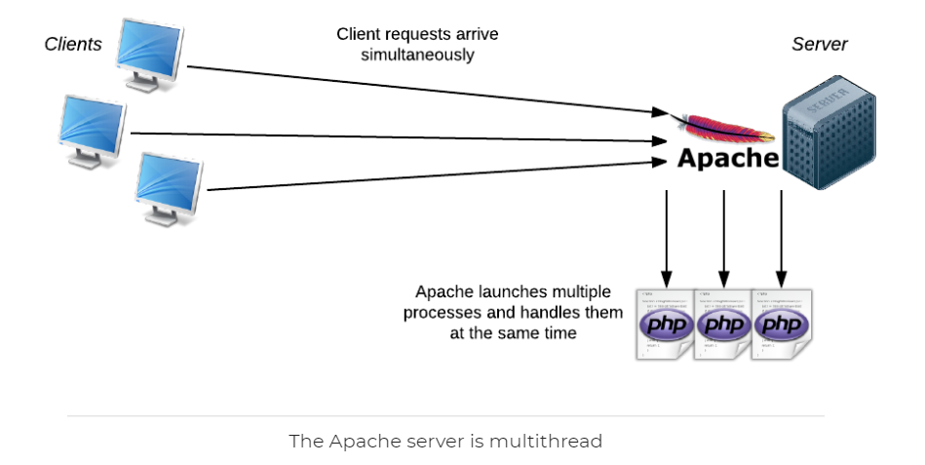
NODE JS
Why Node?

Slide 7

NODE JS
Mono-Thread – Handling multiple Requests?
Node.js doesn’t use an HTTP server like Apache. In fact, it’s up to us to create the server! Isn’t that great?
Unlike Apache, Node.js is monothread. This means that there is only one process and one version of the program that can be used at any one time in its memory.
But I thought that Node.js was really fast because it could manage loads of requests simultaneously. If it’s monothread, can it only perform one action at a time?

Slide 8
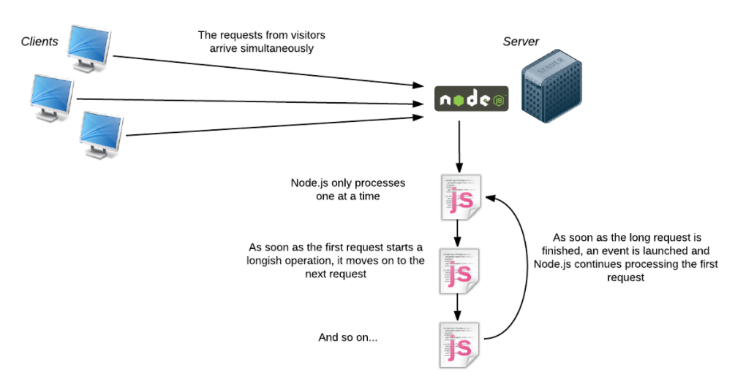
NODE JS
Mono-Thread Style

Slide 9
NODE JS
V8 Engine and C++ Bindings
Chrome needs to run some Javascript for a particular Web page, it doesn't run the JavaScript itself. It uses the V8 engine to get that done so it passes the code to V8 and it gets the results back. Same case with Node also to run a Javascript code.
V8 is written in C++ . chrome and Node are largely written in C++ because they both providing bindings when they're instantiating the V8 engine.
This facilitates to create their own javascript runtime with interesting and novel features.
Example Instance:
Chrome to interact with the DOM when the DOM isn't part of JavaScript.
Node to interact with file system when the file system isn't part of JavaScript

Slide 10
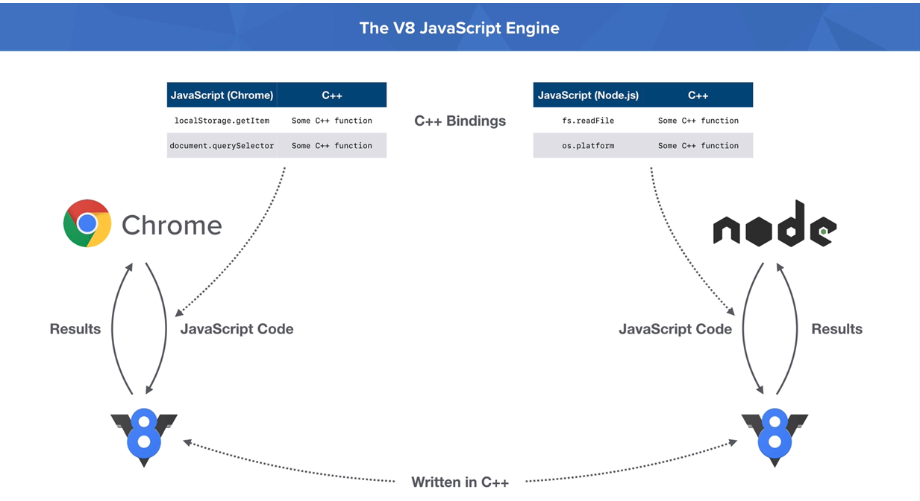
NODE JS
V8 JavaScript Engine
Chrome's not just passing Javascript code to V8, it is also passing down these C++ bindings creating
the context for which the Javascript code should be executed.

Slide 11
NODE JS
Features of Node.js
Asynchronous and Event Driven
Non Blocking I/O
Very Fast
Single Threaded but Highly Scalable
No Buffering
License

Slide 12
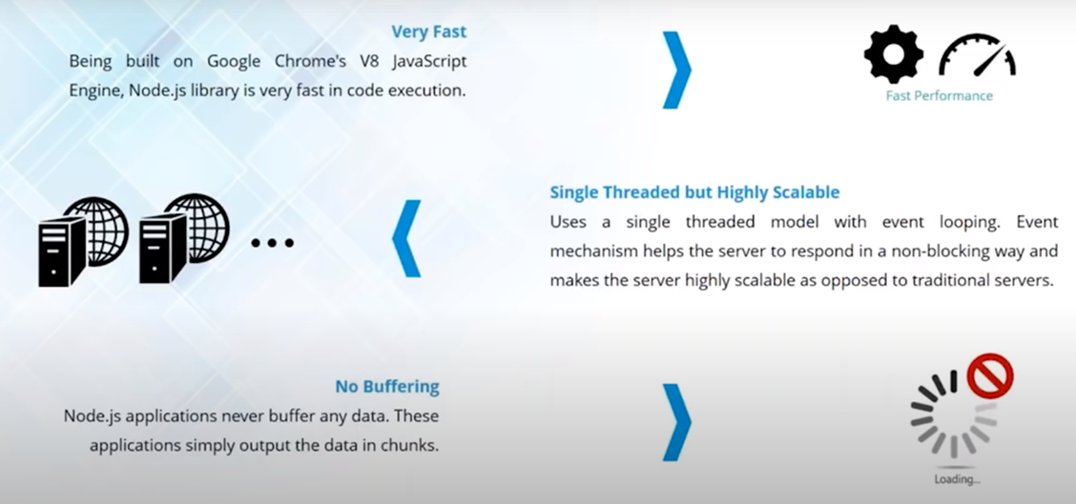
NODE JS
Features of Node.js

Slide 13
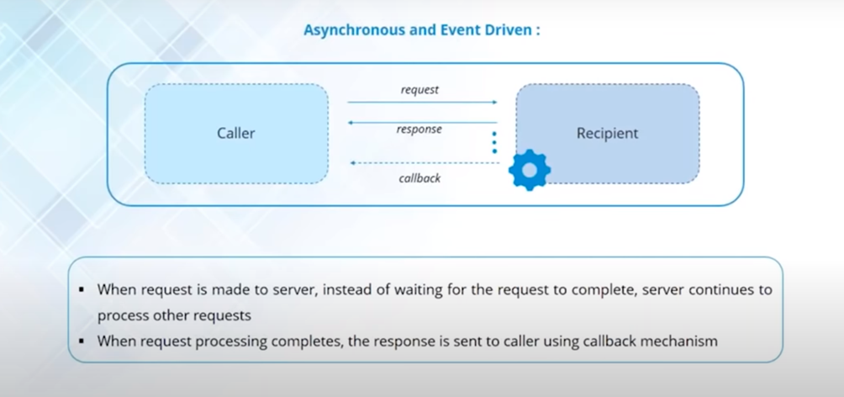
NODE JS
Asynchronous and Event Driven

Slide 14
NODE JS
Callback Functions
Callback is an asynchronous equivalent for a function.
A callback function is called at the completion of a given task. Node makes heavy use of callbacks.
All the APIs of Node are written in such a way that they support callbacks.
For example, a function to read a file may start reading file and return the control to the execution environment immediately so that the next instruction can be executed. Once file I/O is complete, it will call the callback function while passing the callback function, the content of the file as a parameter. So there is no blocking or wait for File I/O. This makes Node.js highly scalable, as it can process a high number of requests without waiting for any function to return results.

Slide 15
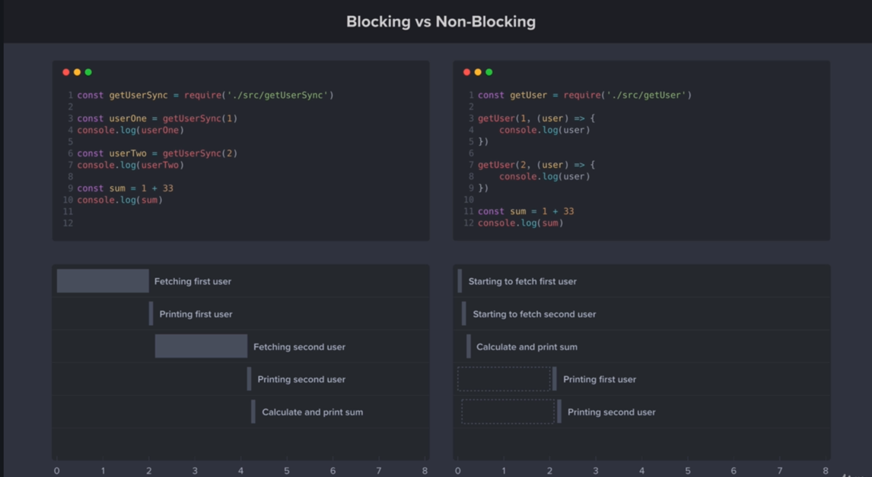
NODE JS
Non- Blocking I/O

Slide 16
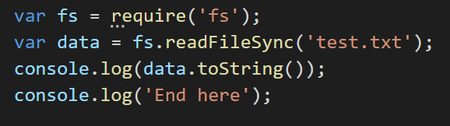
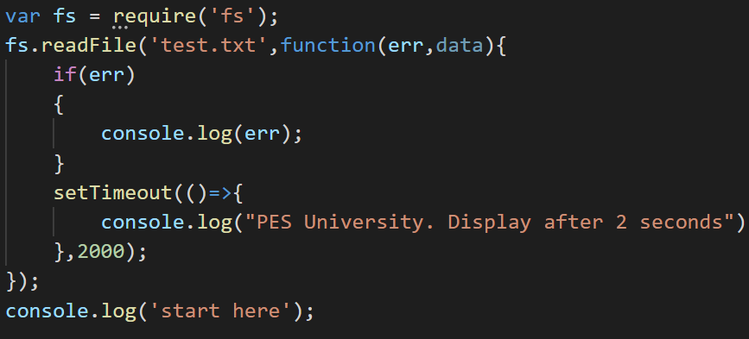
NODE JS
Blocking and Non- Blocking I/O
BLOCKING I/O
NON-BLOCKING I/O

Slide 17
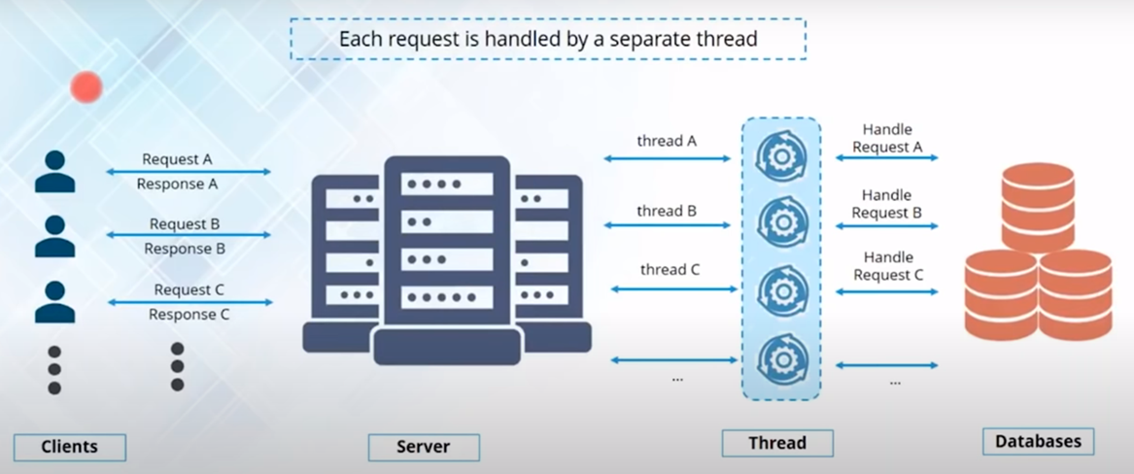
NODE JS
Multi Threaded Model

Slide 18
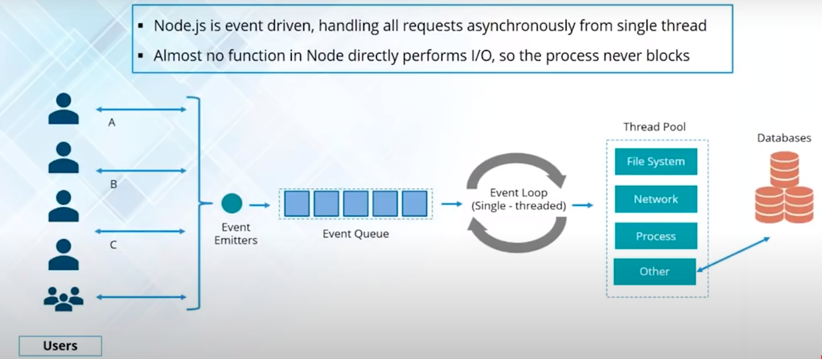
NODE JS
Single Threaded Model

Slide 19
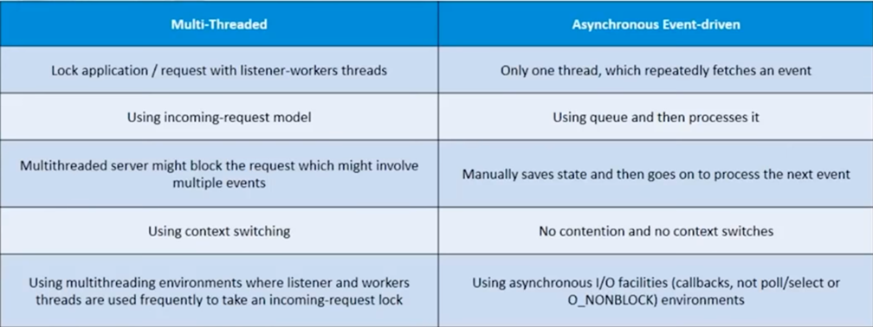
NODE JS
Multi Threaded vs Asynchronous Event Driven Model

Slide 20
NODE JS
Applications of Node.js
I/O bound Applications
Data Streaming Applications
Data Intensive Real-time Applications (DIRT)
JSON APIs based Applications
Single Page Applications
Not for CPU intensive applications.

Slide 21
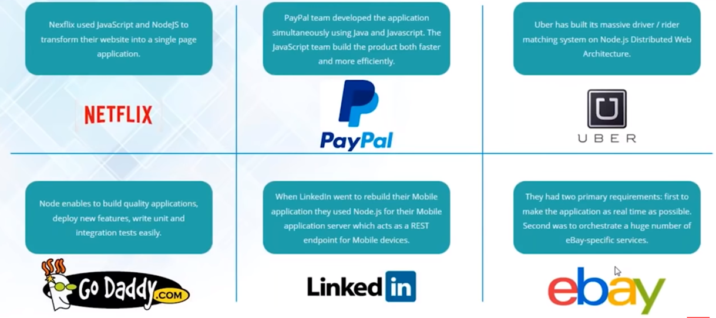
NODE JS
Node JS Success Stories

Slide 22
NODE JS
UBER Story
Customers interact with Uber applications and generating request to book a cab.
Requests are sent to the Uber server to check in the geospatial databases for the cab.
Server send back the card details or driver details back to the customer in form of response.
Disadvantage of Multi Threaded model in this case:
Every request is assigned a new thread from thread pool and it gets exhausted. Scalability is very poor
Whenever a thread is working on a shared resource. It acquires a lock on
that resource.

Slide 23
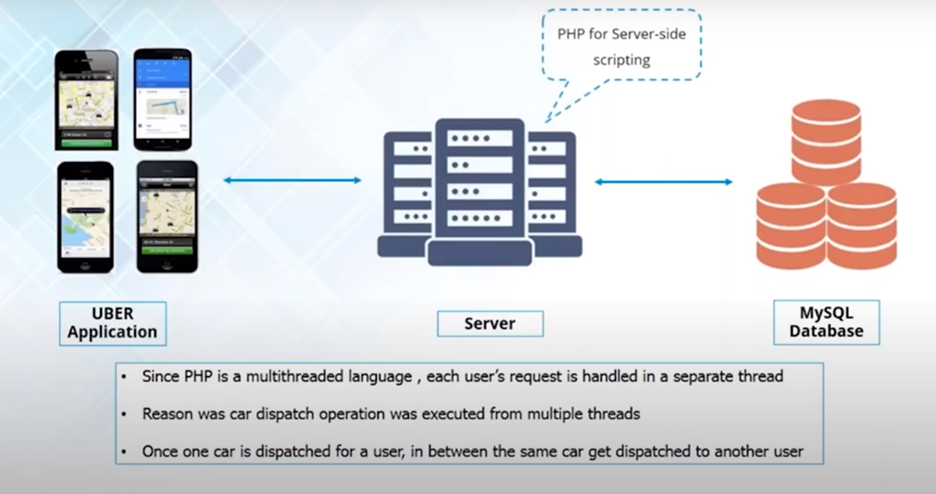
NODE JS
UBER Story – Old Architecture

Slide 24
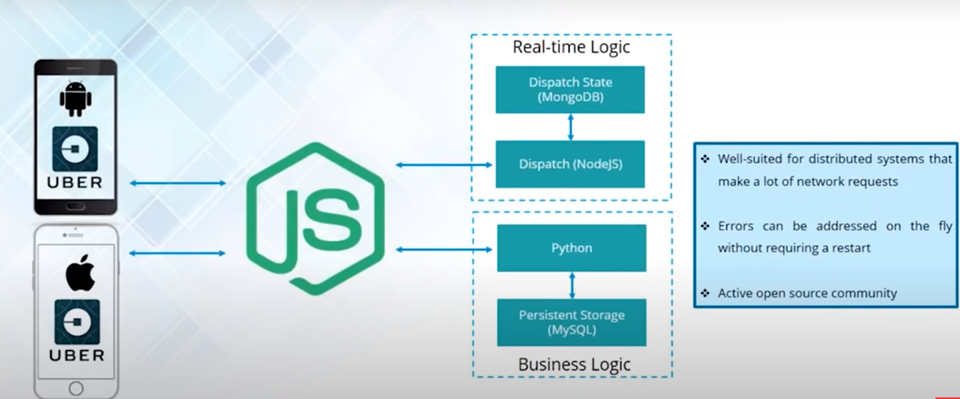
NODE JS
UBER Story – New Architecture

Slide 25
NODE JS
UBER Story – Single threaded Model
User performs an activity or event is generated, each new request is taken as an event.
Event Emitter emit those events and then those events reside inside the event queue in the server.
Events are executed using event Loops,which is a single thread mechanism
A worker thread present inside the thread pool is assigned for each request.
Only one thread in this event Loop will be handling the events directly and process will never get Blocked.

Slide 26

NODE JS
Node JS installation
Go to https://nodejs.org/en/
Look for the Latest Stable Version and download it
After Installing, Verify the installation by giving the command as
Install a editor like Visual Code, Sublime Text or any suitable editors for running Node JS Applications

Slide 27
THANK YOU
Aruna S
Department of
Computer Science and Engineering
arunas@pes.edu

